Slide 1

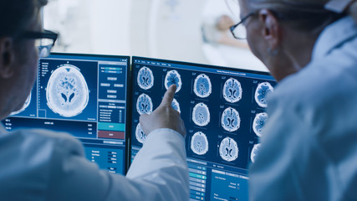
SDAIA T5 DATA SCIENCE BOOTCAMP
Brain Tumor MRI
Deep Learning
Abdulmajeed Alnfaie
Ahmabd Hakami
Nouf Alshabani

Slide 2
Introduction
Dataset
Transfer Learning Models
Agenda
Agenda
Complex Neural Networks
Deployment
Tools
Conclusion

Slide 3
Introduction
A brain tumor is a collection, or mass, of abnormal cells in your brain. Brain tumors can be cancerous (malignant) or noncancerous (benign). When benign or malignant tumors grow. This can cause brain damage, and it can be life-threatening.
Inspiration
Building a model to determine whether there is a brain tumor or not and its type if any, using Convolutional Neural Networks

Slide 4
Dataset Information
4997
1705
706
Train
Validation
Test
#
Four classes for each of them

Slide 5
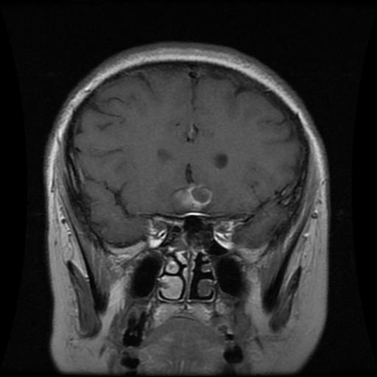
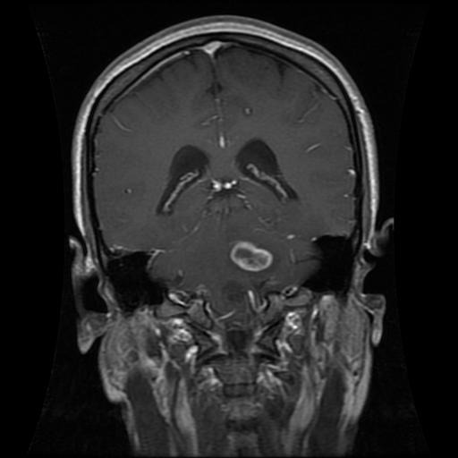
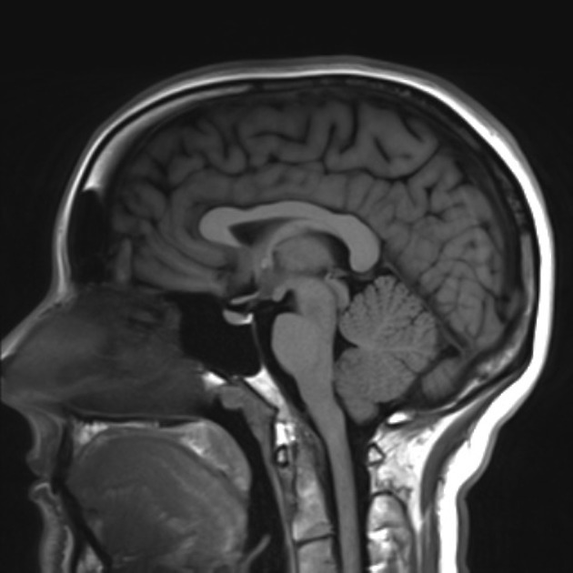
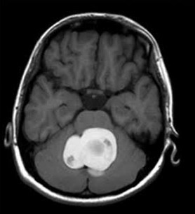
Sample of Dataset
Pituitary
Glioma
Notumor
Meningioma

Slide 6

Transfer Learning Models
val_accuracy | val_loss | Acuraccy | Model
0.77 | 3.6 | 0.86 | ResNet
0.73 | 2.5 | 0.83 | VGG16
0.58 | 11 | 0.63 | VGG19

Slide 7
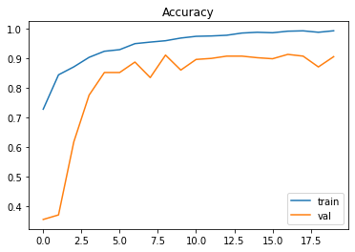
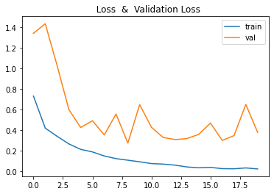
Complex Neural Networks
01
Conv2D
Size of Filter = (7,7)
MaxPooling2D = 2.2
Dropout = 0.3
Dense = 1024
Activation = SoftMax
Optimizer = SGD
Test Accuracy = 90%

Slide 8
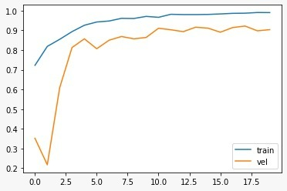
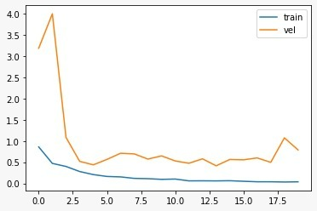
Complex Neural Networks
Accuracy
Loss
02
Conv2D
Size of Filter = (3,3)
MaxPool2D = (2,2)
Dropout = 0.5
Dense = 64
Activation = Soft-Max
Optimizer = Adam
Test Accuracy = 91%

Slide 9
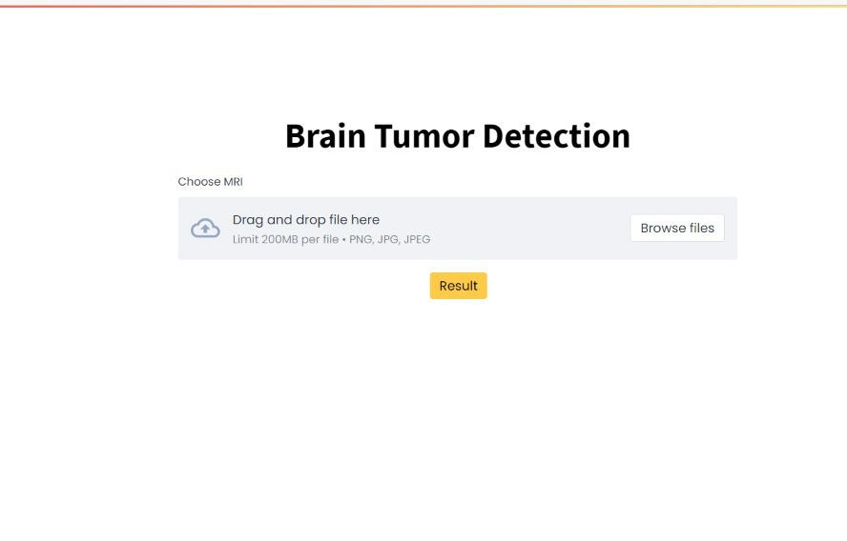
Deployment
Deployment

Slide 10




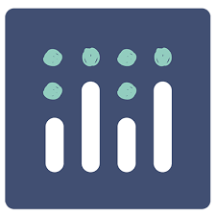
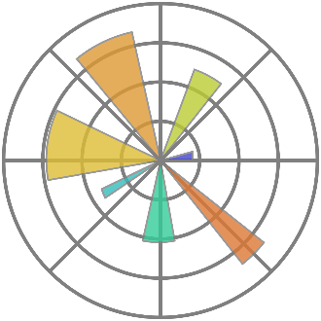


Tools
Tensorflow
Google Colab
Keras
Python
Matplotlib
PyCharm
Streamlit

Slide 11

Conclusion
The importance of early diagnosis of brain tumor, as early diagnosis of brain tumor can contribute to ensuring immediate treatment that reduces the risks of death, and through artificial intelligence, we have contributed to building a model for diagnosing the brain tumor with high speed and accuracy.
Future Works:
Develop the model to include all types of radiation

Slide 12
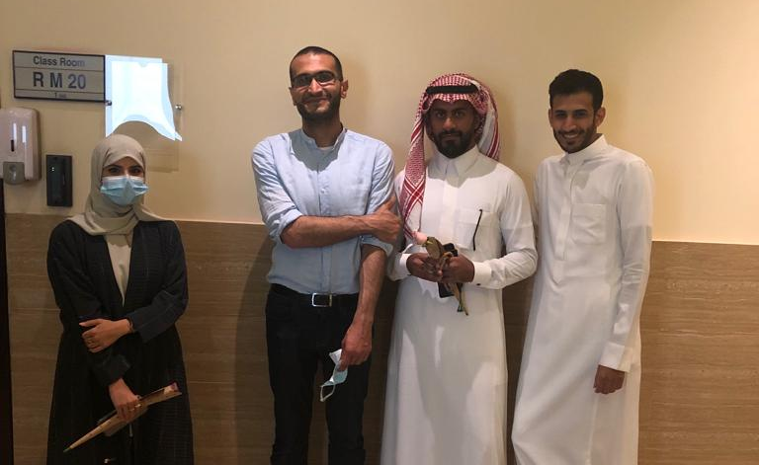
Thank you Dr. Patrick!
From the left: Nouf, Dr. Ptrick, Abdulmajeed, Ahmad

Slide 13
Thank you!

Slide 14
Thank you too!
Any Questions?
Abdulmajeed
Nouf
Ahmad
Github @AbdulamjeedAlnefaie
Github @NoufAlshabani
Github @AhmadHakami

